Slide 1
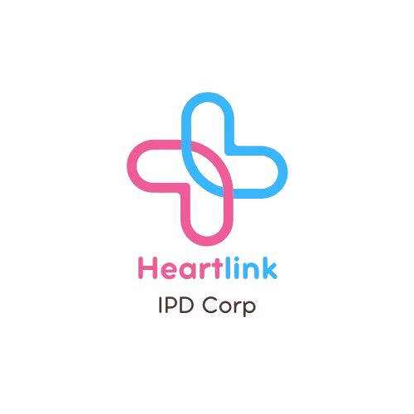

HEARTLINK – Heart Rate Tracking and Analysis
Course: MGMT-6134-31-25F Capstone Project
Milestone 2: System Design & Prototyping
Presented by: Ivan Guan, Gbubemi Diden, Patrick Dinh
Professor: Vinnie Moraes
Date: October 18, 2025

Slide 2





Project Overview
Real-Time Monitoring
Continuous heart rate and oxygen tracking using wearable sensors
Integrated System
Hardware, cloud, and web integration for seamless data flow
Complete Visualization
Data acquisition, visualization, and intelligent alerts

Slide 3
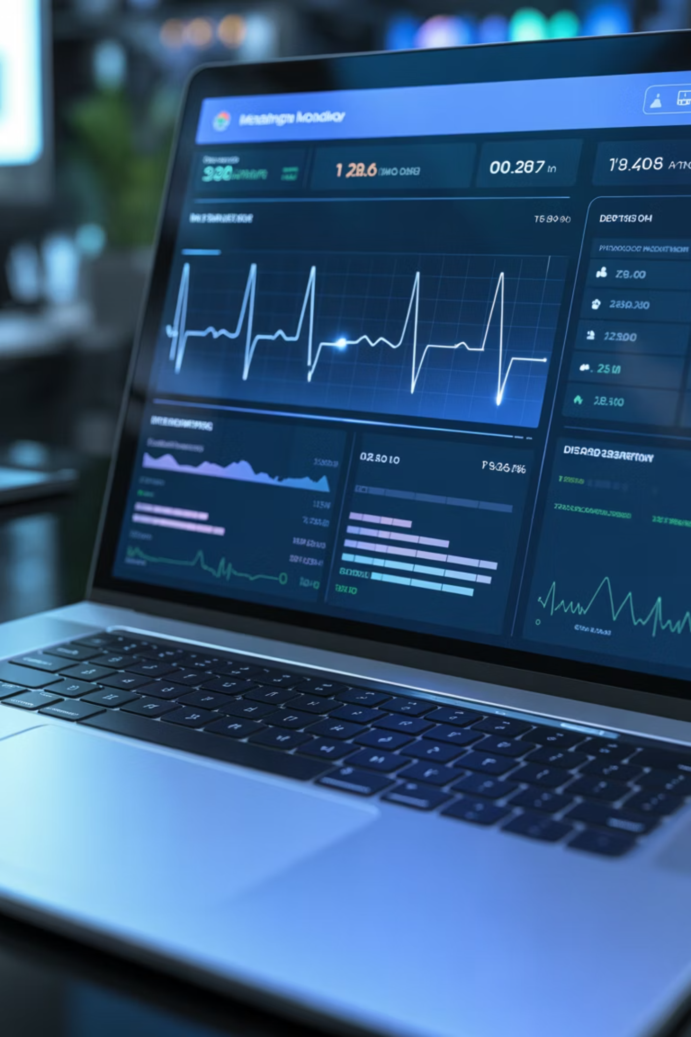
Project Objectives
01
Build Scalable Infrastructure
Create a reliable heart rate monitoring system that can grow with user needs
02
Ensure Efficient Data Flow
Optimize data transmission, security protocols, and user-friendly dashboard design
03
Support Comprehensive Features
Enable live monitoring, history tracking, and
customizable alert systems

Slide 4

Technology Selection
Hardware & Development
Cloud & Visualization
Cloud Infrastructure:
Development Tools:
Google IoT Core
Google Pub/Sub (real-time ingestion)
Arduino IDE
PlatformIO
BigQuery (data warehouse)
GitHub
Open-source
MAX30102 library
ESP-IDF
Visualization Stack:
Google Looker Studio
React.js
Chart.js
D3.js

Slide 5
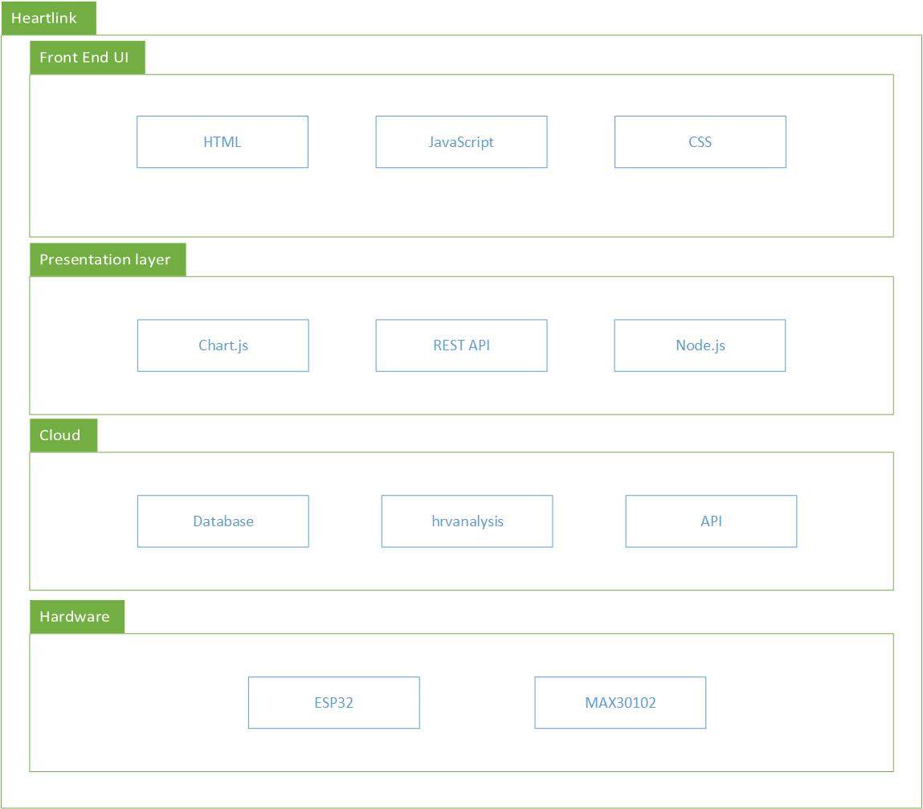
System Architecture
Real-Time Transmission
Instant data flow from sensor to cloud infrastructure
Secure Cloud Storage
Protected data warehousing with enterprise-grade security
Instant Visualization
Live dashboard updates for immediate health
insights

Slide 6
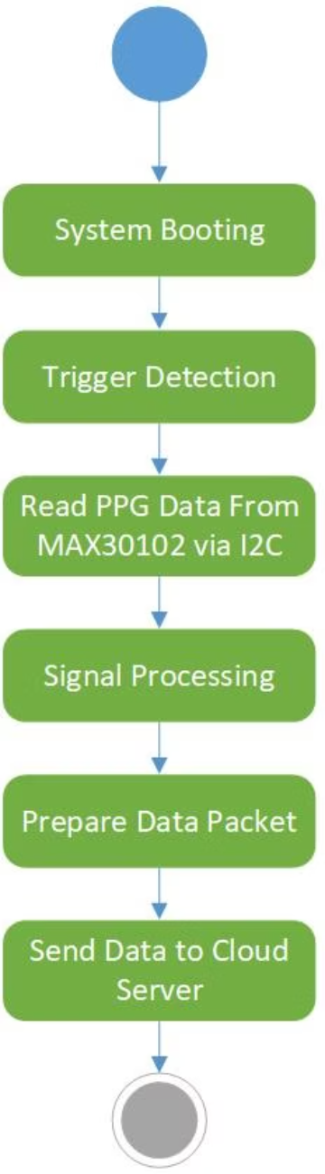
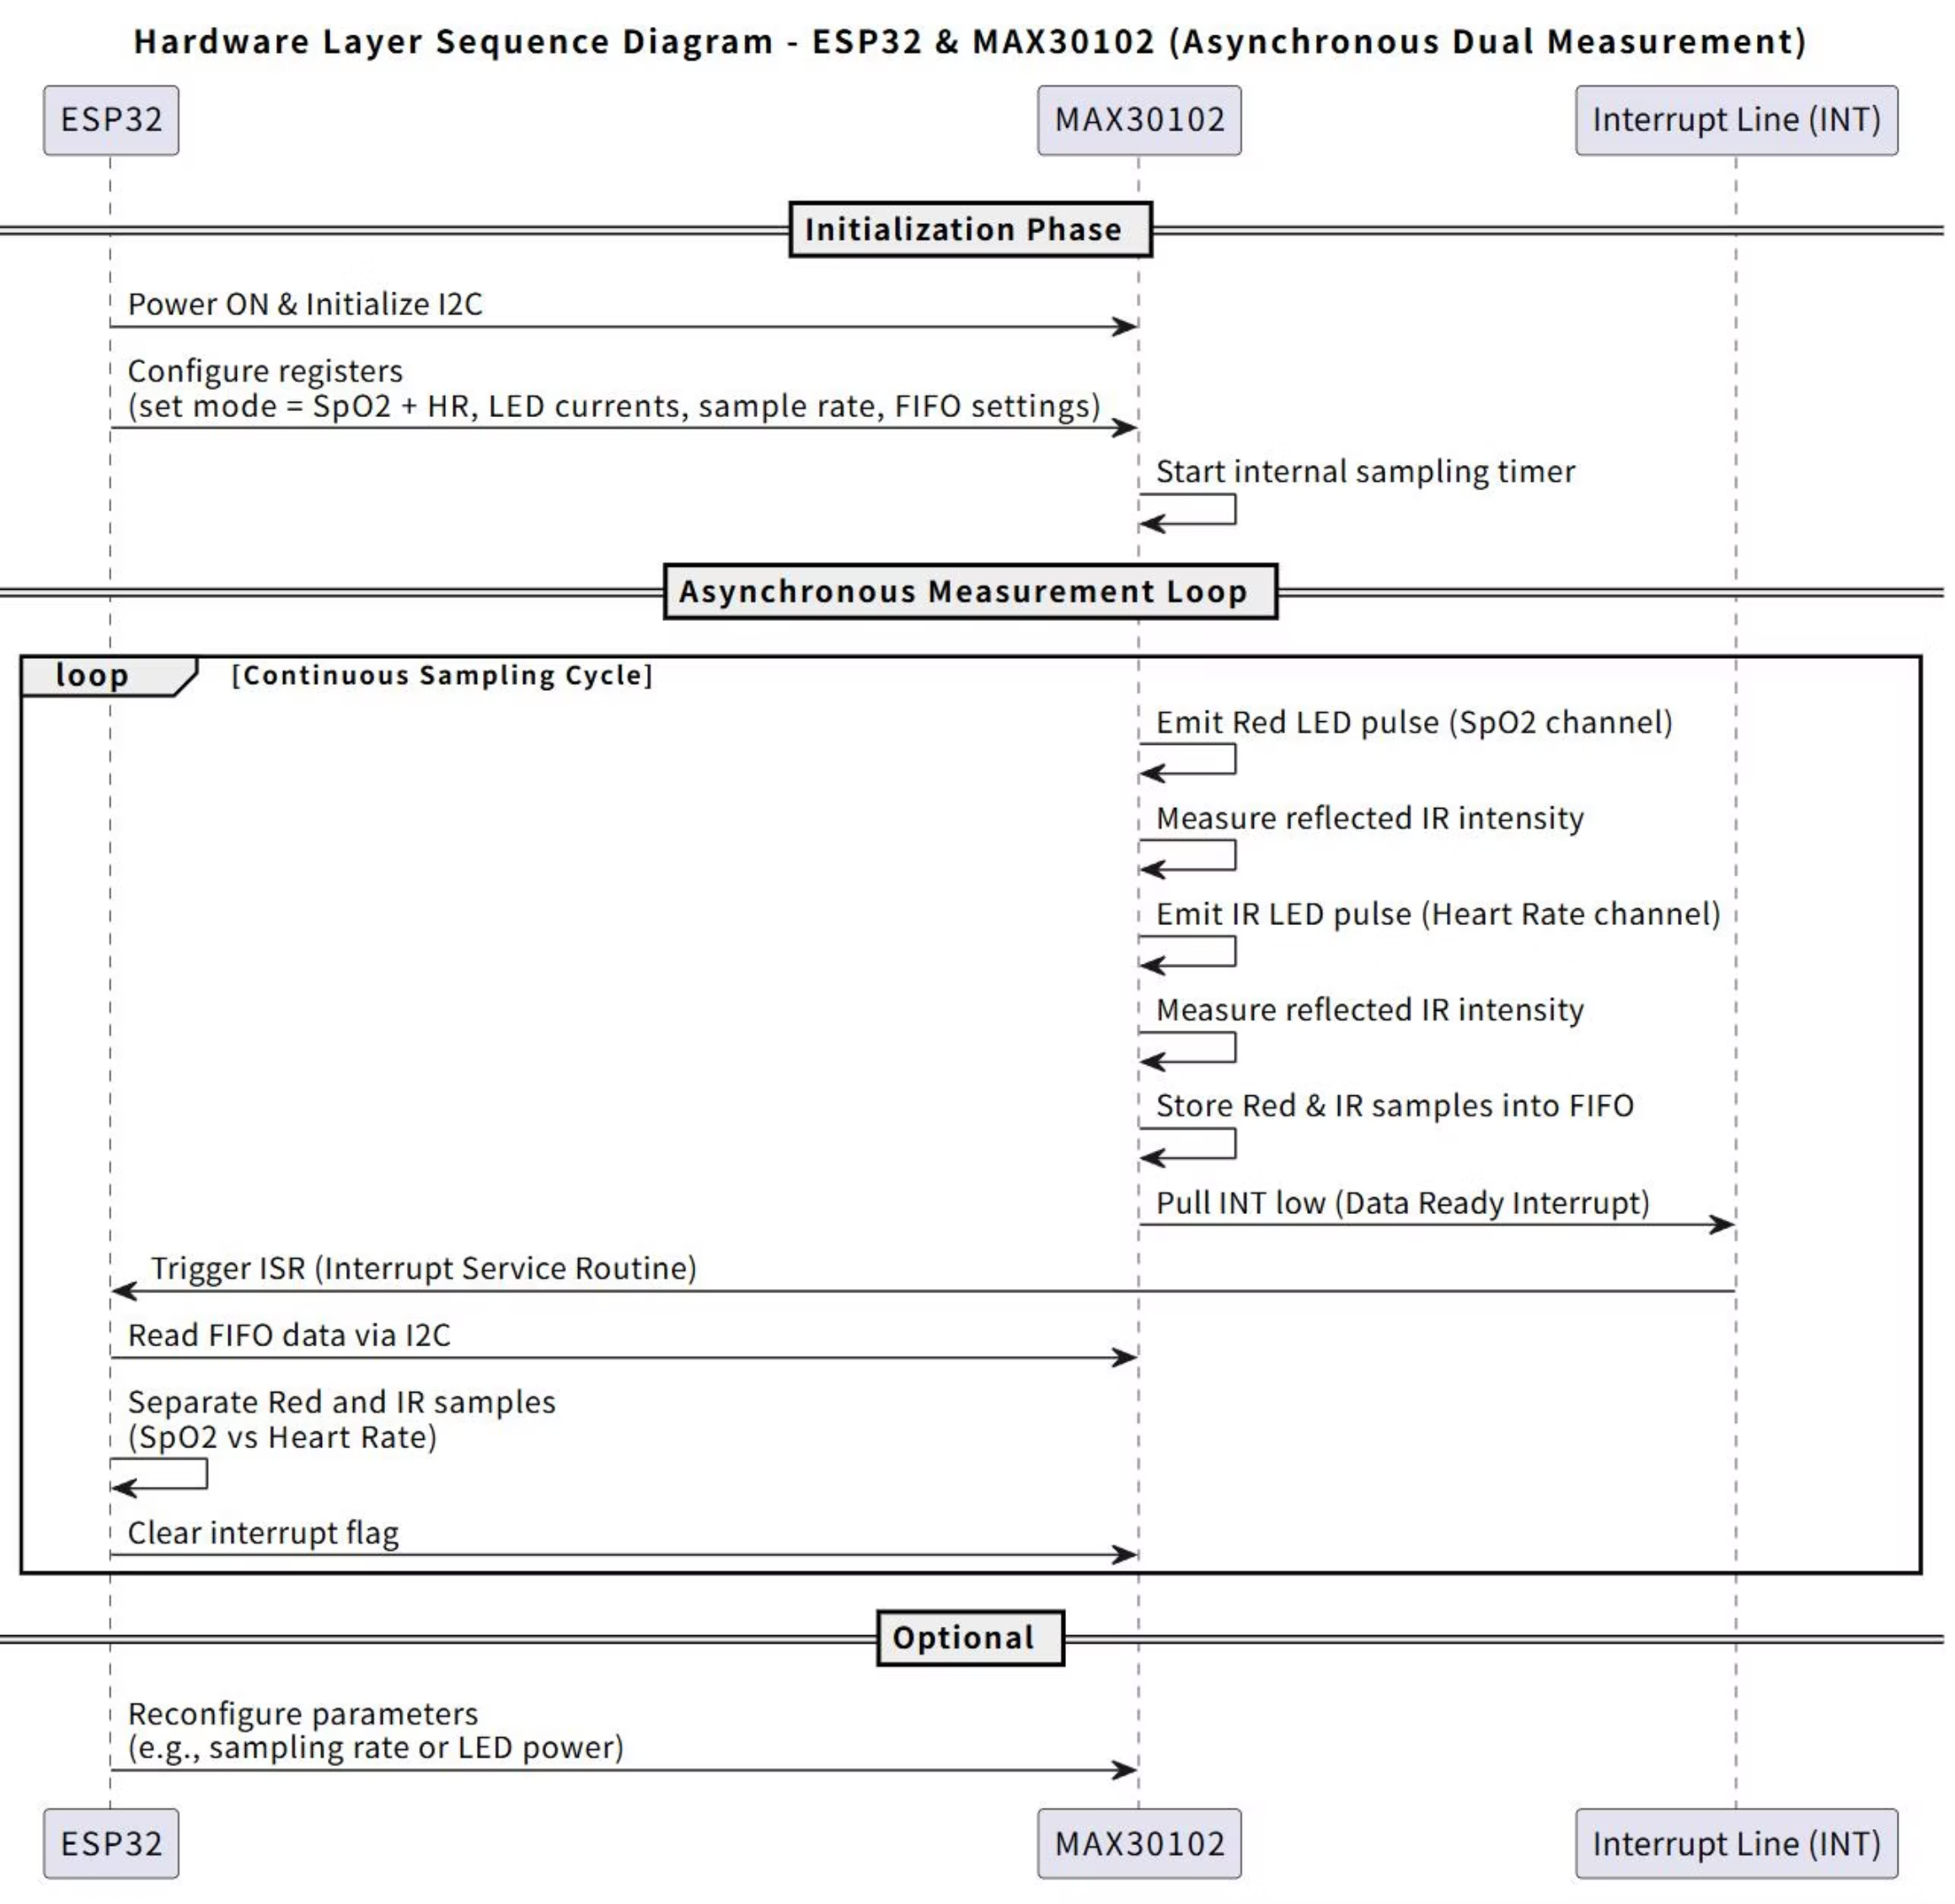
Hardware UML Diagrams
Flow Chart
Sequence Diagram

Slide 7
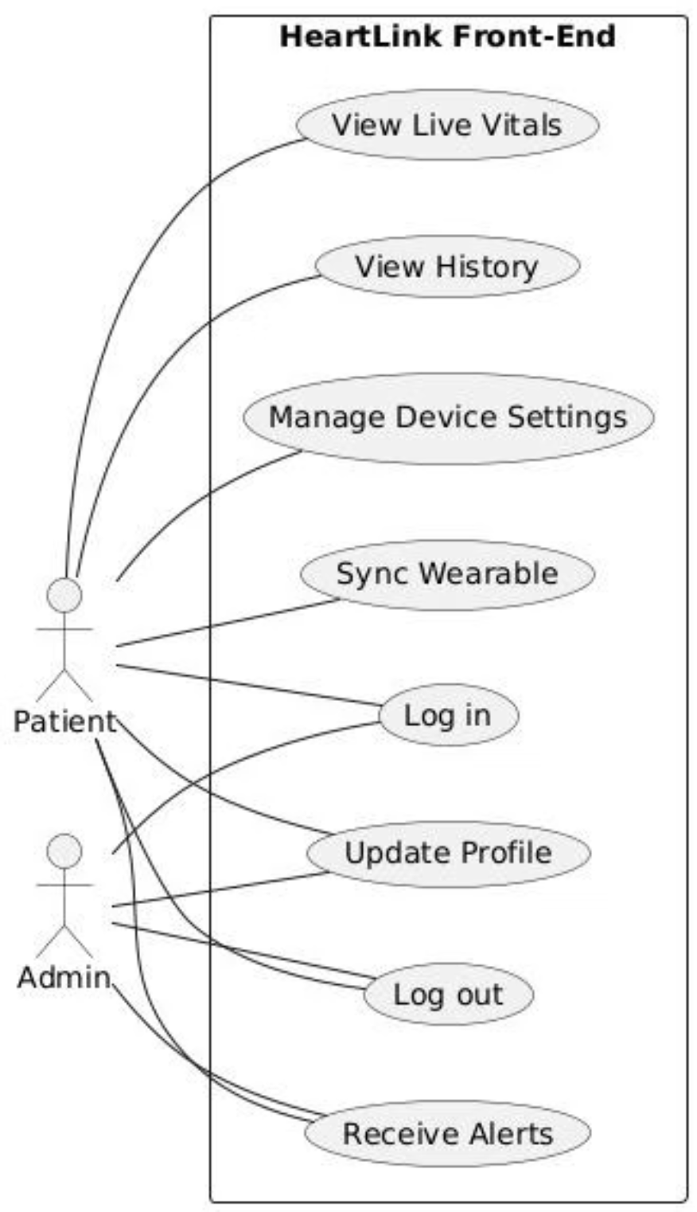
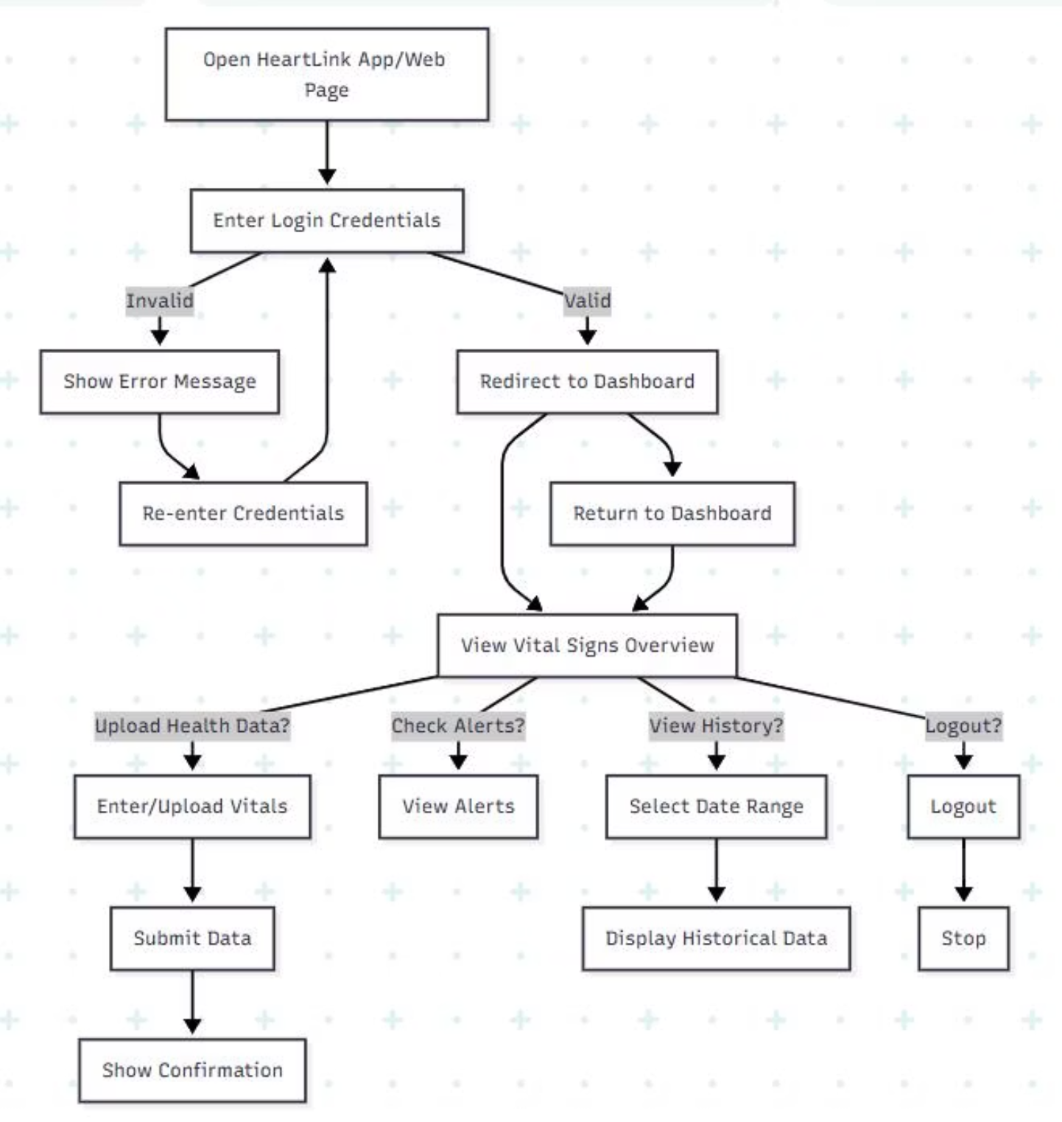
Front-End UML Diagrams
Use Case Diagram
Activity Diagram

Slide 8
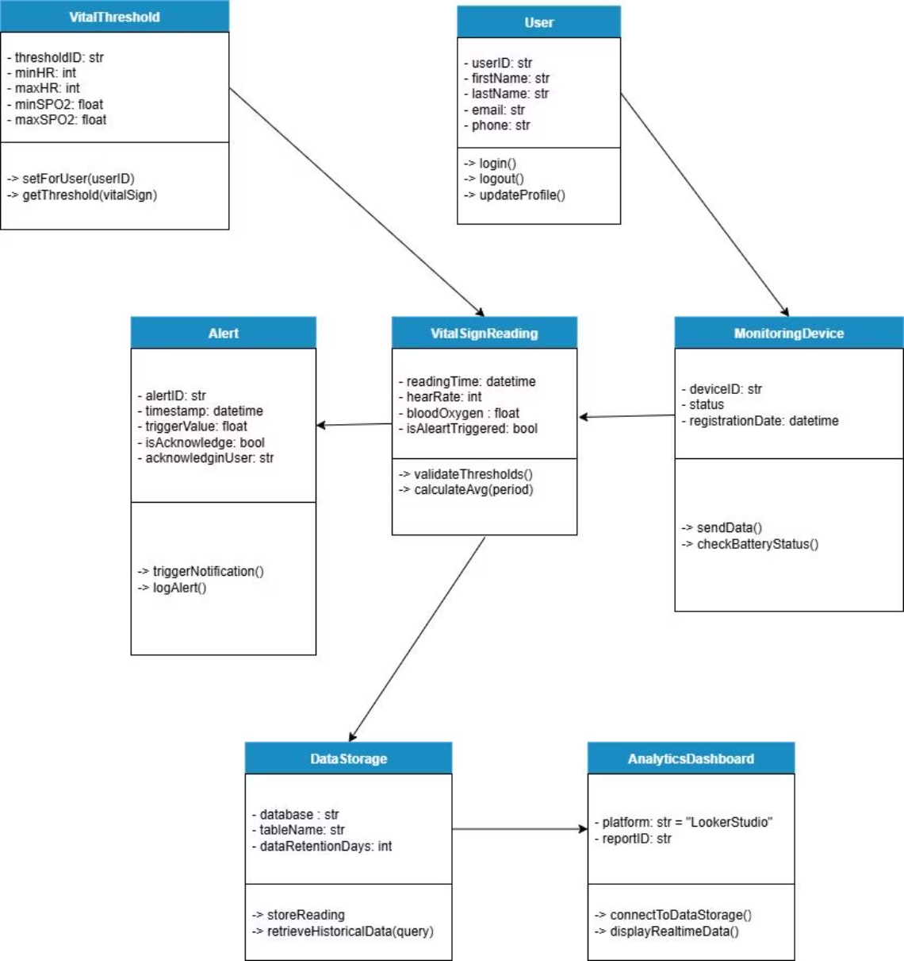
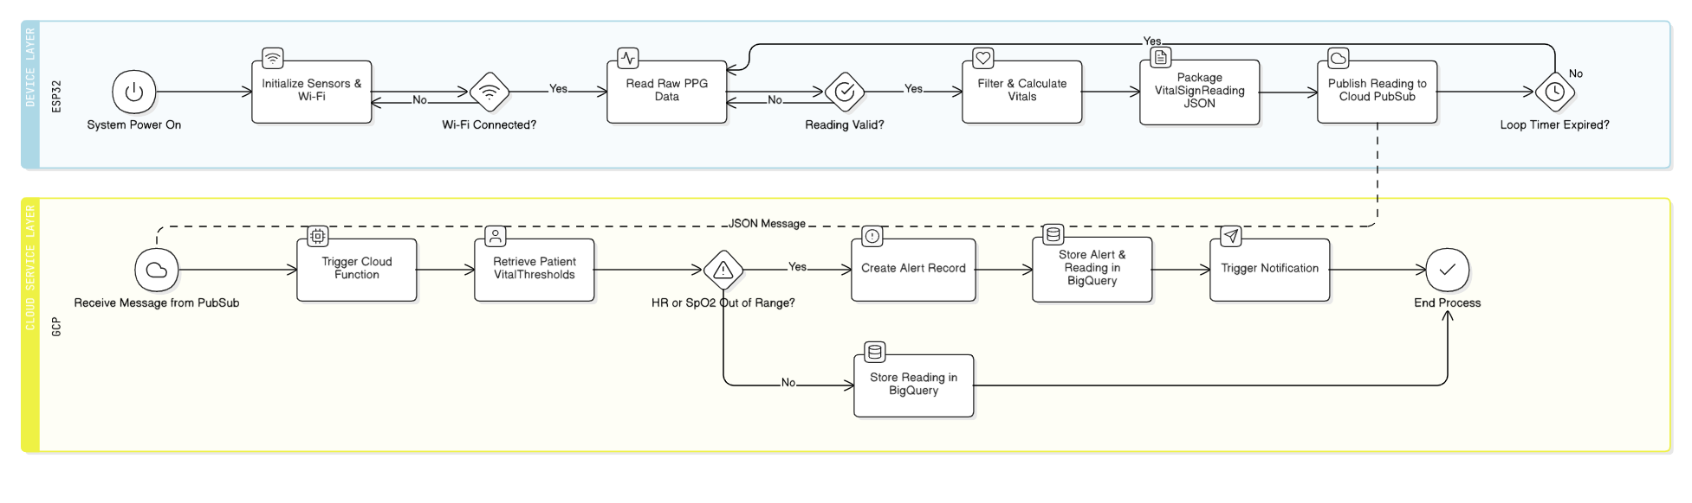
Cloud Layer UML Diagram
Flow Chart
Class Diagram

Slide 9
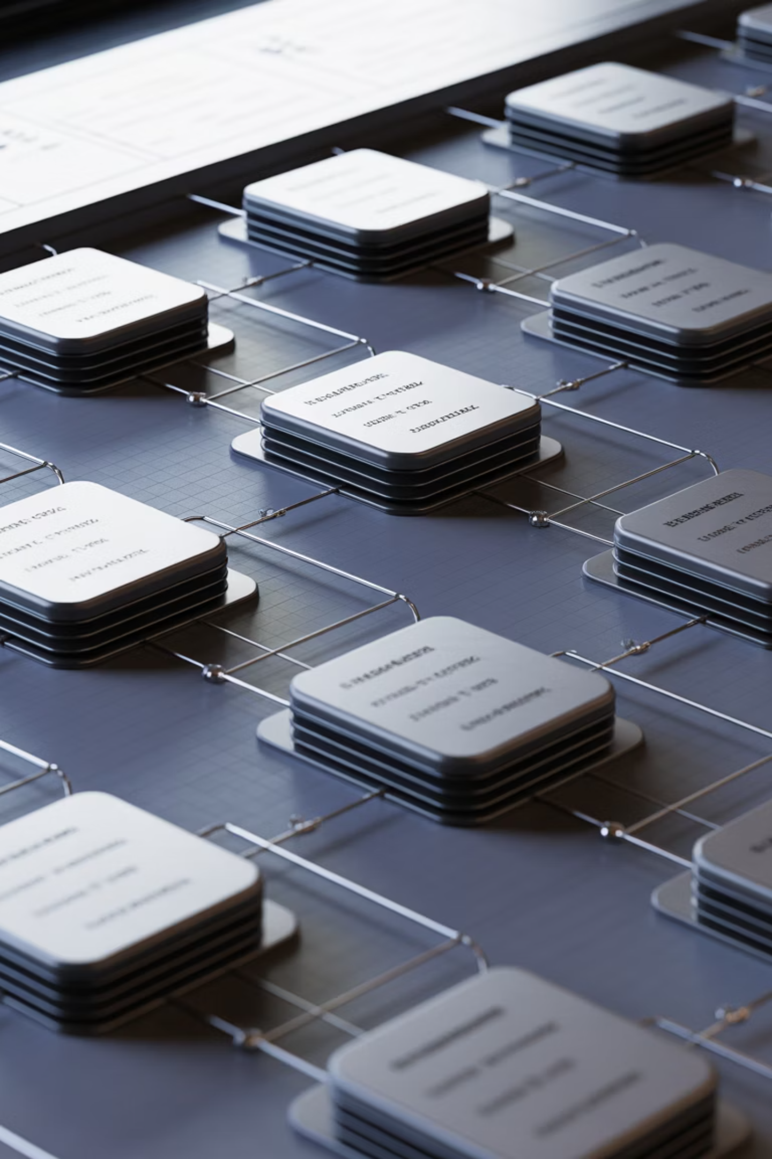
Data Dictionary
Core Data Fields
System Entities
Sensor Data:
Device Data:
timeStamp
DeviceID
deviceId
Model
redAdc, irAdc
RegistrationDate
heartRate
Readings:
spo2
uploadStatus
ReadingID
ReadingTimestamp
User Information:
HeartRateBPM
UserID
SpO2Level
FirstName, LastName
Alerts:
Role
Email, Phone
AlertID
Type (HRHigh, HRLow,
SpO2Low)
Acknowledged status

Slide 10
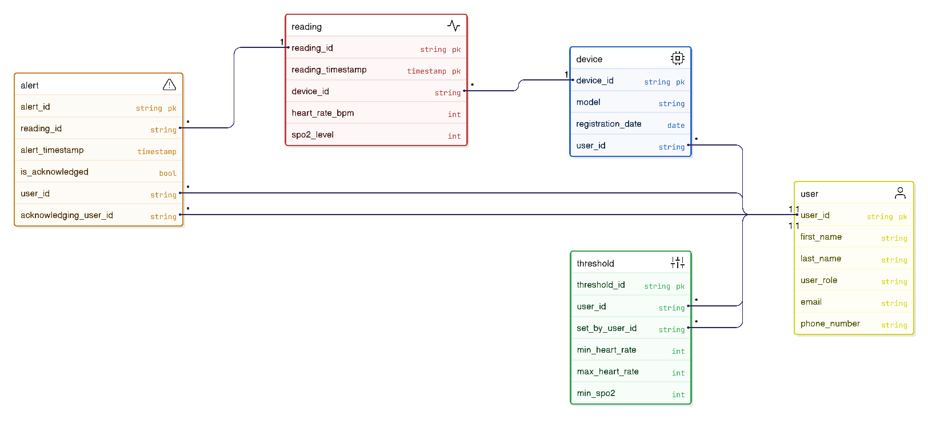
Entity Relationship Diagram
The ER diagram illustrates the complete database structure, showing how users, devices, readings, and alerts interconnect to create a robust data architecture for the HEARTLINK system.

Slide 11
UI/UX Prototype
Live Monitor
Alerts Panel
Historical Data
Device Status
Real-time display of current vital signs with instant updates
Active alerts and error notifications for immediate attention
Past readings and trend analysis for long-term tracking
Connection monitoring and comprehensive setup guide
Built in Figma, the prototype emphasizes accessibility and clarity. Design principles include clean layout, color-coded signals, and responsive design for desktop and tablet devices.

Slide 12
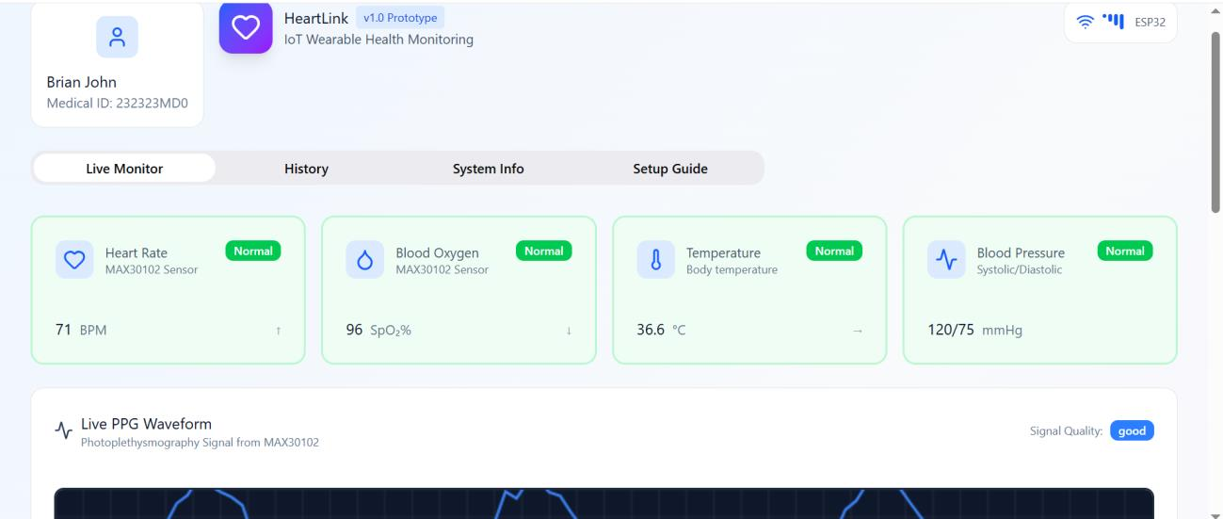
UI/UX Prototype Draft
The prototype showcases the complete user interface with intuitive navigation, clear visual hierarchy, and responsive design elements that adapt to different screen sizes and user needs.

Slide 13

Webpage Structure Overview
1
2
State Management
VitalSignsMonitor
Controls device connection status with simulated timeout functionality
Displays live heart rate and vital statistics
3
4
LiveWaveform
HistoricalData
Real-time waveform and ECG graph visualization
Archive of past vital sign readings
5
6
AlertsPanel
DeviceStatus
Active alert notifications and warnings
Real-time connection status monitoring
Additional Components
Technical Framework
SystemInfo: Device and system information
UI Framework: TailwindCSS
SetupGuide: Pairing and setup instructions
Tabs Navigation:
Live Monitor
History
System Info
Setup Guide
DisclaimerBanner: Legal disclaimer
Footer: Webpage footer elements

Slide 14
References
Instructables. (2023, June 3). Guide to Using MAX30102 Heart Rate and Oxygen Sensor With
Arduino. Instructables. https://www.instructables.com/Guide-to-Using-MAX30102-HeartRate-and-Oxygen-Sens/?utm_source=chatgpt.com
UML Use Case Diagram Tutorial. (2025, August 22). Lucidchart.
https://www.lucidchart.com/pages/tutorial/uml-use-case-diagram
SmartDraw. (2019). SmartDraw - Create Flowcharts, Floor Plans, and Other Diagrams on Any
Device. Smartdraw.com. https://www.smartdraw.com/
Espressif Documentation. (2025). Espressif.com.
https://documentation.espressif.com/esp32_datasheet_cn.pdf
Introduction to GitHub. (2022, October 18). GitHub. https://github.com/skills/introduction-togithub
Figma. (2021). Figma. Figma. https://www.figma.com/community
(2025). Fanshaweonline.ca.
https://www.fanshaweonline.ca/d2l/le/content/2001609/viewContent/17909532/View
All APIs and references. (2025). Google Cloud. https://cloud.google.com/pubsub/docs/apis
Node.js client library. (n.d.). Google Cloud.
https://cloud.google.com/nodejs/docs/reference/iot/latest
Welcome to Looker Studio! (2025). Google Cloud. https://cloud.google.com/looker/docs/studio
Sullivan, H., & Lin, M. (2021). Cloud-Centric IoT Data Processing: A Multi-Platform Approach
Using AWS, Azure, and Snowflake. 2, 12–23. https://doi.org/10.63282/3050-
9416.ijaibdcms-v2i1p102

Slide 15



Thank You
Thank you for your attention. We welcome your questions on any aspect of the HEARTLINK project, including system architecture, technology choices, design decisions, or future development plans.
Technical Questions
System architecture, implementation details, technology stack
Design Inquiries
UI/UX decisions, user experience, accessibility features

